Slide 1
ITP4913M FYP Interim Present
Group: Edward Ma 9 Supervisor: Mr. Ma Siu Kwong, Edward Co-Marker: Ms. Yuen Oi Sheung, Ada
Students:
Wong Ming Yuen, Siu Chi Wang,
Kwok Tsz Lung, Chau Yat Sum

Slide 2
Presentation Outline
Objectives
Problem Background
Project Outline
Function Provided
Client Side
Server Side
High-level Analysis
Use Case Diagram
Sequence Diagram
Summary of Finished Progress

Slide 3
Objective
Main objective
Provide visualized climatic data from UAV
Multi-platform
Android App
Windows App
UAV

Slide 4
Problem Background
Large amount of exhaust emission is released industry high-speed development
Harmful to human's health
Observatory cannot provide accurate data for every region
Some places human cannot arrive easily
Disaster area
Mountain

Slide 5
Project Outline
UAV
Window Application
Android Application

Slide 6
Functions Provided
We can connect to the UAV through different platforms.
Android app:
Control UAV
View live stream
Take photo or video during live stream

Slide 7
Functions Provided
Windows app:
Data Collection
Display real-time view from UAV
Display location of UAV on map
Display details of UAV
Build up new mission
Generate graphs instantly when climatic data is received

Slide 8
Functions Provided
UAV:
Provide visualized climatic data to user
Temperature
Humidity
UV Level
PM2.5
Allow live stream

Slide 9
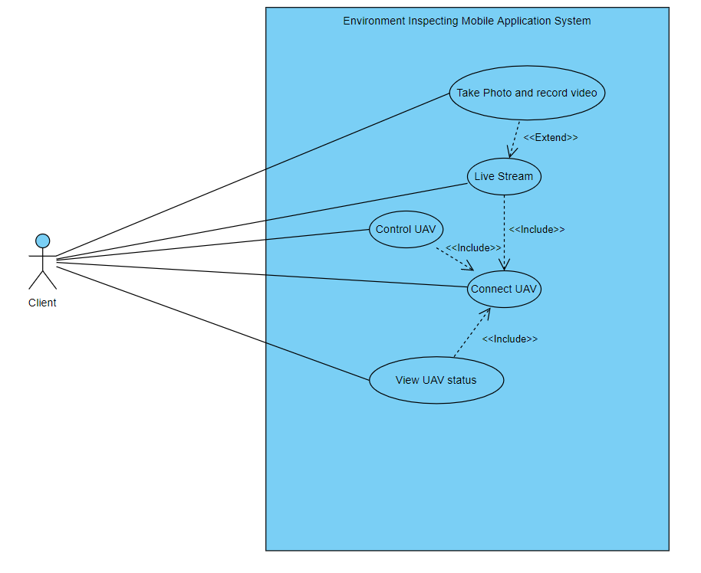
Use Case of Mobile App

Slide 10
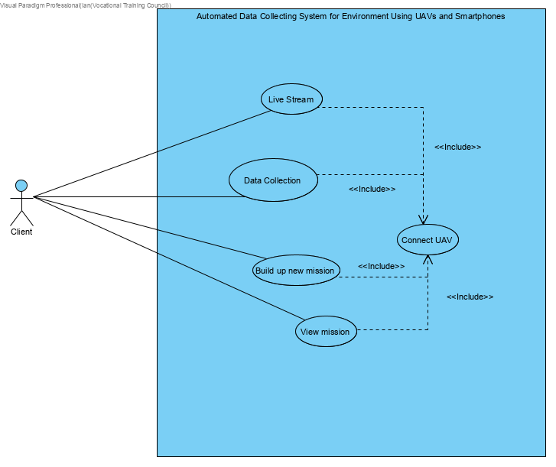
Use Case of Windows App

Slide 11
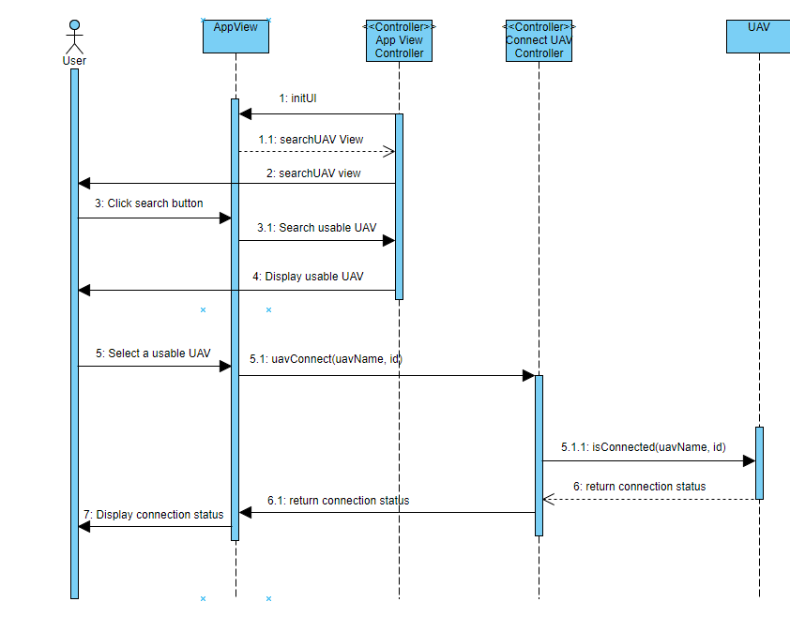
Sequence Diagram of Android App(Connect UAV)

Slide 12
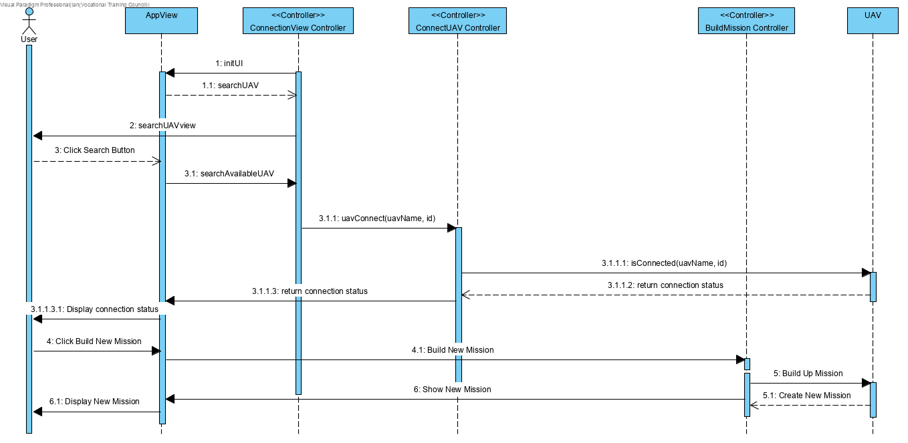
Sequence Diagram of Windows App (Build New Mission)

Slide 13
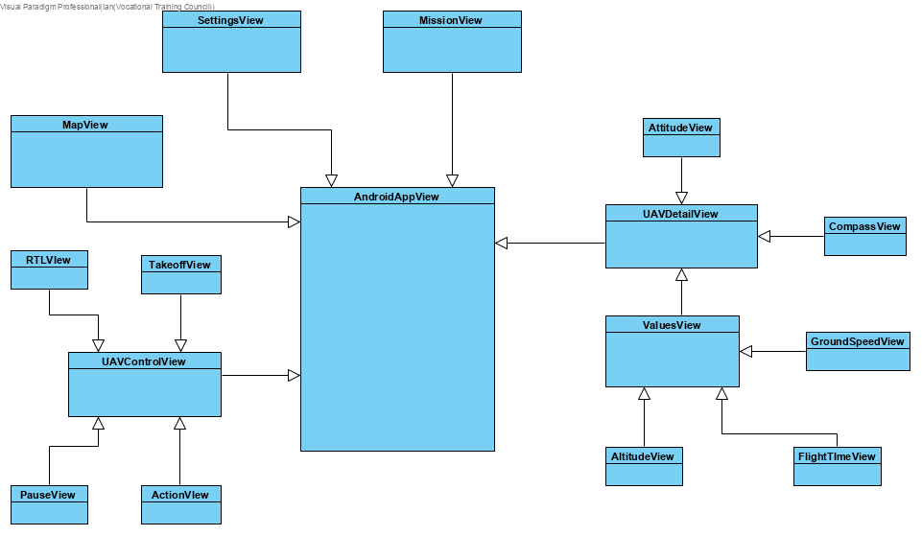
Class Diagram of Android App

Slide 14
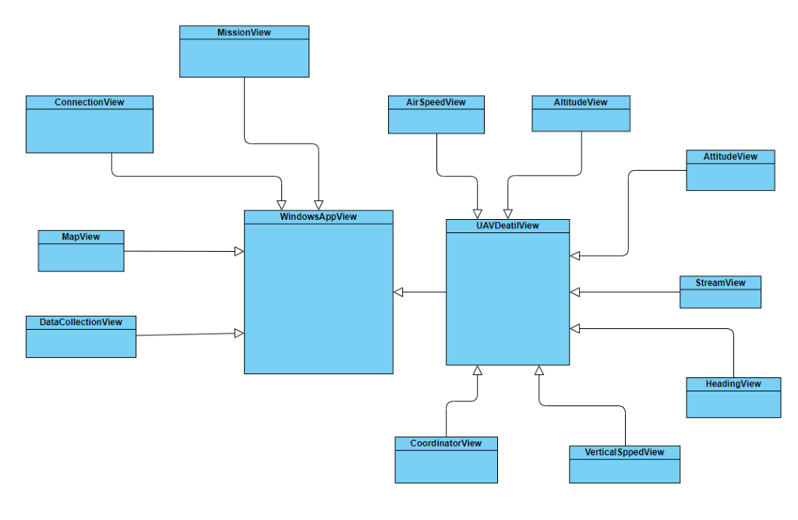
Class Diagram of Windows App

Slide 15
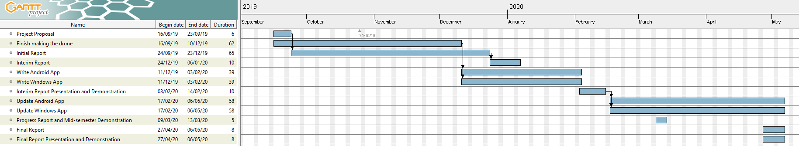
Project Schedule

Slide 16
Critical Environment
Network stability
Server performance problem
Battery capacity limitation
Fire risk with LiPi battery
Weather problem(e.g. strong wind)

Slide 17
Summary of Finished Process
Mobile app:
Display real-time view from UAV
Control UAV
Display location of UAV on map
Display details of UAV
Take photo or video during live streaming
UAV:
Collect visualized climatic data
Windows app:
Build up new mission
Data collection
Display real-time view from UAV
Display location of UAV on map
Display details of UAV
Analyse climatic data

Slide 18
End Of Presentation

